Slide 1
Design, Implementation and Management of Database Systems
Course Training 1: ER model
Dr. Xiao Yan
School of Computer Science
yanxiaosunny@whu.edu.cn

Slide 2
Part One: Review
Basic ER-model Notations

Slide 3
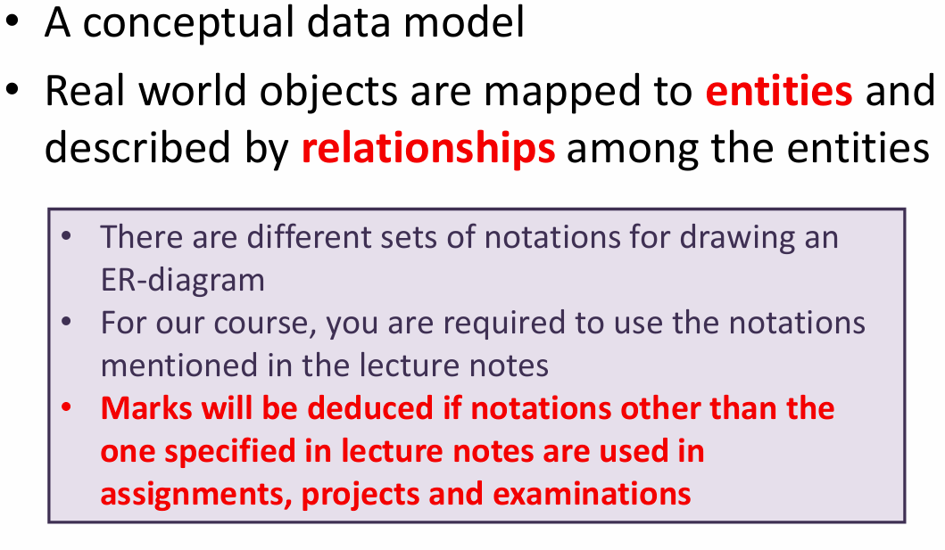
ER-model

Slide 4
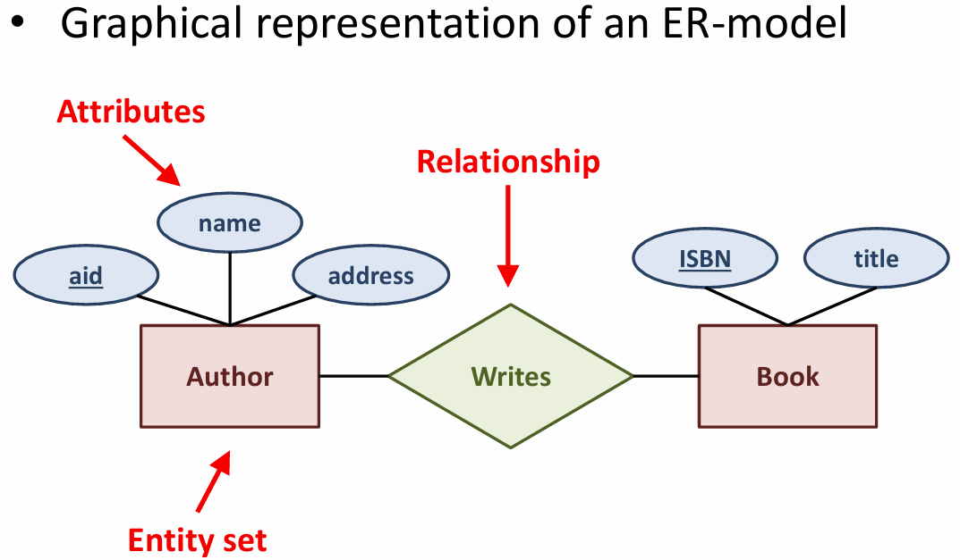
ER-diagram
Notes:
Note: Attribute not exclusive to relationships, can be on entity also

Slide 5
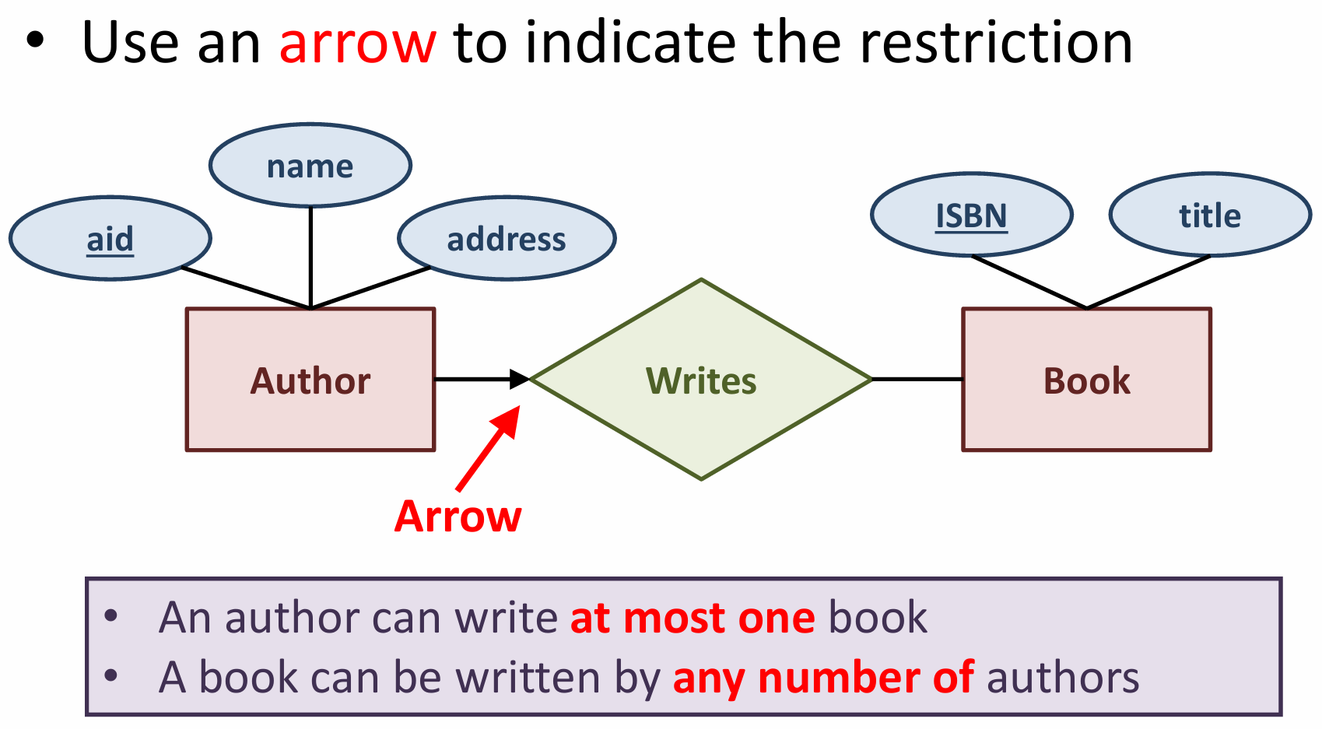
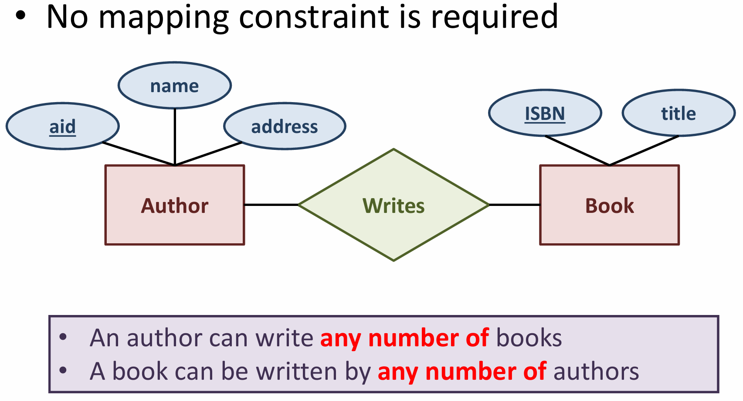
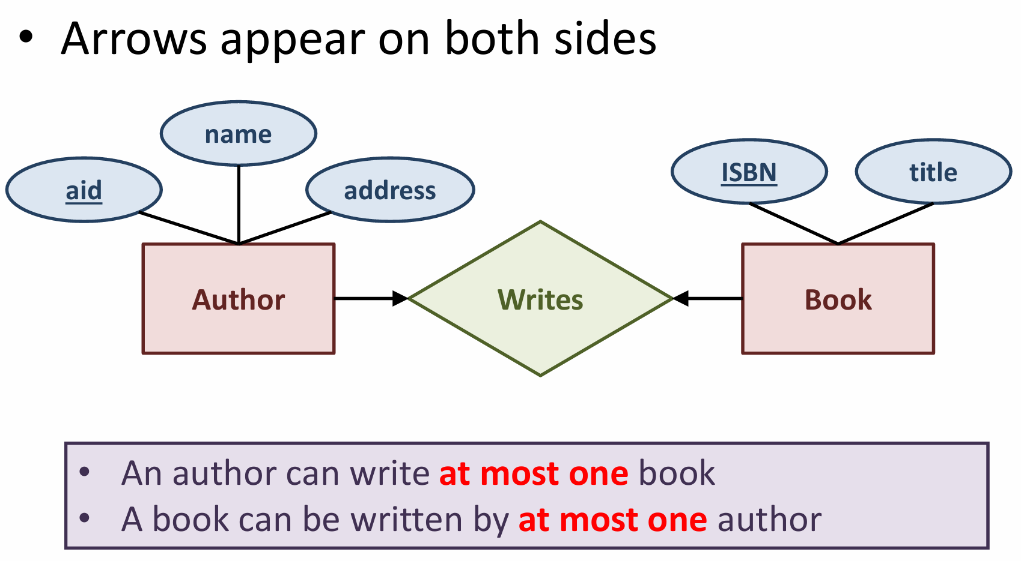
Relations
Notes:
For TA: same setting, guide concept different meaning of the relationship

Slide 6
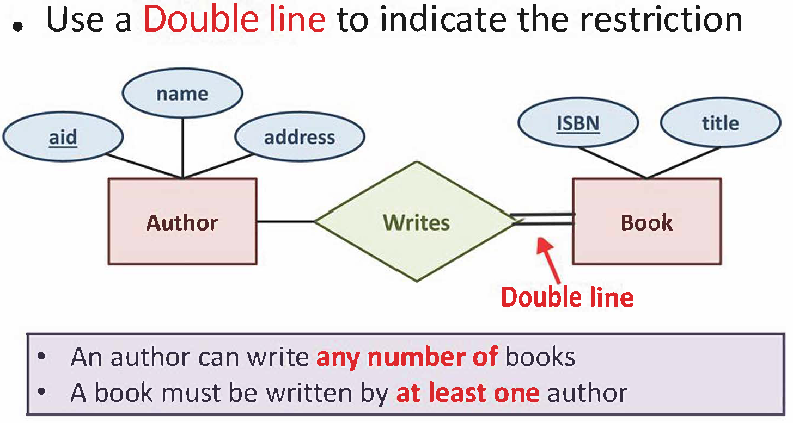
Total-Participation
Notes:
For TA: student will be confused about, best give counter example to say this is not okay etc

Slide 7
Practice by Example
Library Database

Slide 8
Library Database
A book is uniquely identified by its book-id. For each book, we also record its title, price, and availability.
A reader is uniquely identified by his/her reader-id and we also record his/her name, phone number and address. The address is composed of street and suburb.
A publisher is uniquely identified by its publisher-id. For each publisher, the name is also recorded.
An author is uniquely identified by his/her author-id. For each author, the name, phone number and birth date are also recorded.
A reader can borrow zero or more books and a book can be borrowed by zero or more readers. Thus, we need to record the starting date and ending date for the borrowing relationship.
A publisher can publish zero or more books and a book is published by exactly one publisher. We also need to record the date of publication.
An author can write zero or more books and a book is written by one or more authors.

Slide 9
Think and discussion (6 Min)
Think by yourself.
Quietly discuss with nearby students.
Cheat sheet
Line: any number
Arrow: at most one
Double line: at least one
Double line with arrow: exactly one

Slide 10
Step 1: identify entity sets
Book
Reader
Publisher
Author

Slide 11
Step 2: add relationships
Borrow
Book
Reader
Publish
Write
Publisher
Author

Slide 12
Step 2.5: add constraints to relationships
Borrow
Book
Reader
Publish
Write
Publisher
Author

Slide 13
Step 3: add attributes
Title
Price
Name
Number
Availability
Id
Id
Book
Suburb
Borrow
Reader
Street
Starting Date
Ending Date
Publish
Publish Date
Write
Publisher
Author
Id
Id
Name
Birthday
Name
Number

Slide 14
Another Example
University Database

Slide 15
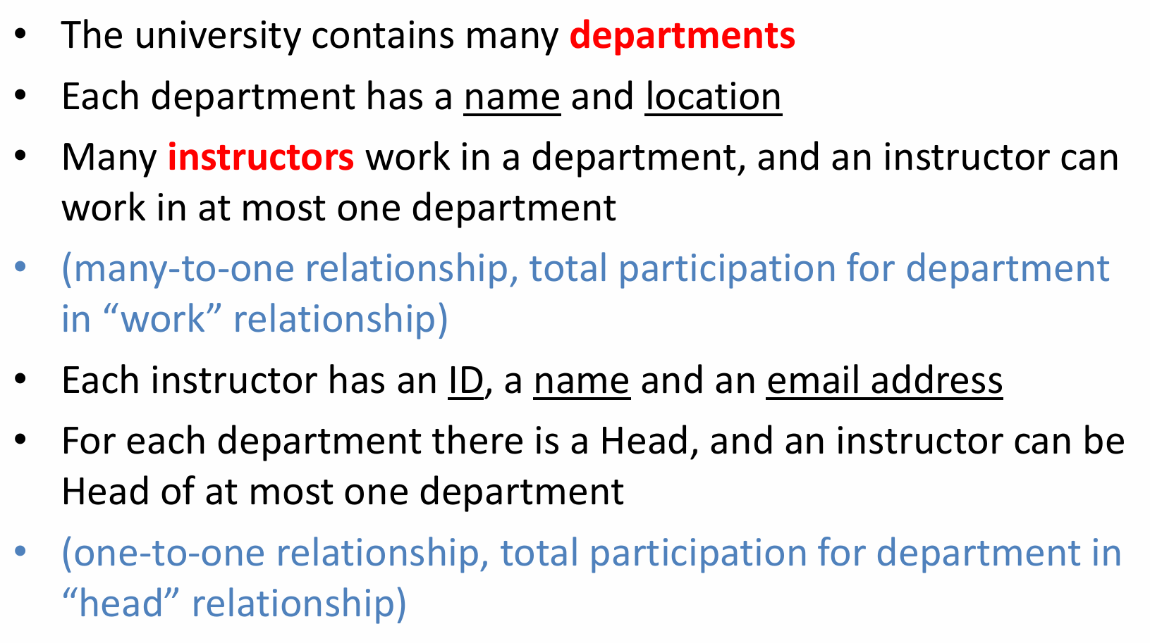
University Database

Slide 16
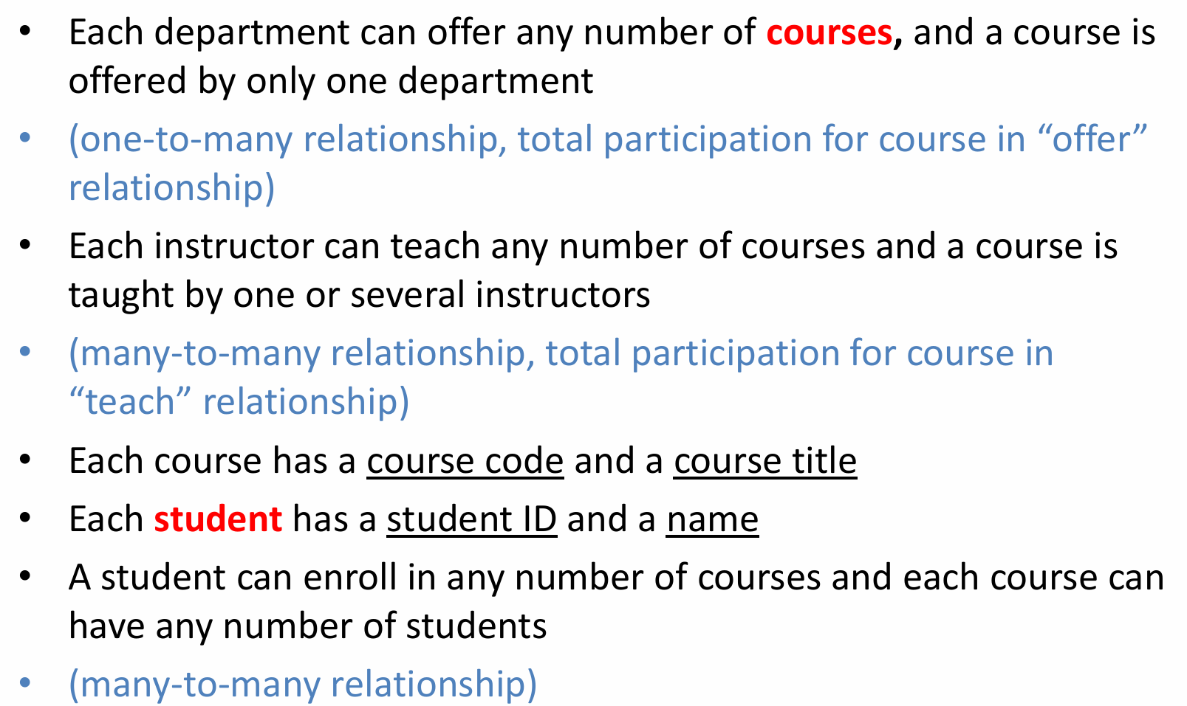
University Database

Slide 17
Think and discussion (6 Min)
Think by yourself.
Quietly discuss with nearby students.

Slide 18
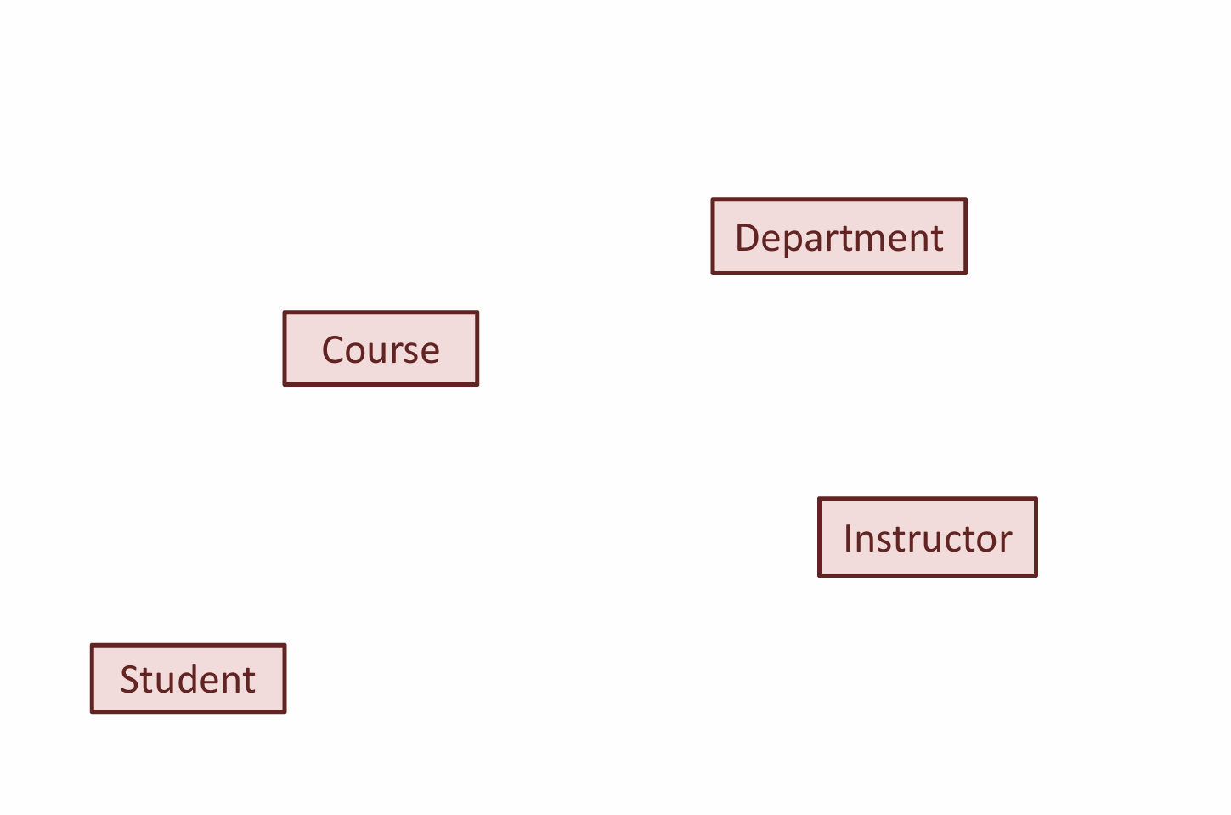
Step 1: identify entity sets

Slide 19
Step 2: add relationships
Offer
Department
Course
Instructor
Student

Slide 20
Step 2: add relationships
Offer
Department
Course
Enroll
Instructor
Student

Slide 21
Step 2: add relationships
Offer
Department
Course
Enroll
Teach
Instructor
Student

Slide 22
Step 2: add relationships
Offer
Department
Course
Head
Enroll
Teach
Instructor
Student

Slide 23
Step 2: add relationships
Offer
Department
Course
Head
Work
Enroll
Teach
Instructor
Student

Slide 24
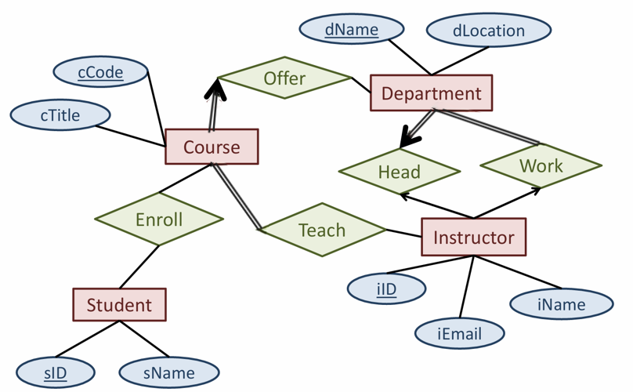
Step 3: add attributes

